Slide 1

Evidence-based portfolio diversification for strategic entry into the aviation market by Abigael Kariuki

Slide 2

Outline of the presentation
Overview of the business problem
Data overview and main trends
Data analysis
Recommendations

Slide 3
Overview of the business problem
This project analyses aviation accident data to assess the risk of fatal and severe accidents to guide the company's entry into the aviation industry
Key factors analysed:
Flight phases: impact of takeoff, landing, cruise etc on accident severity.
Weather conditions: how factors like rain, fog, and wind contribute to accidents.
Aircraft types and engines: correlation between aircraft models, engine types, number of engines and accident fatality risk.
Purpose of flight: relationship between accident severity and flight purpose (commercial, private, training).
Accident severity: classification of accidents based on injury severity (fatal, serious, minor).
Business challenge: the company is expanding into aviation to diversify its portfolio but lacks knowledge about the risks involved in entering this market
Goal: assesses the risks of entering the aviation industry, focusing on factors that impact safety and success. The findings will inform decisions on managing risks and ensuring safety as the company expands into aviation operations.

Slide 4
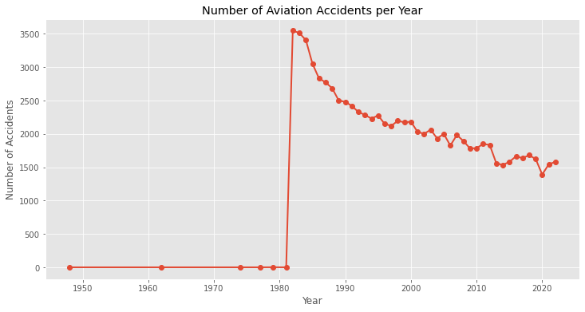
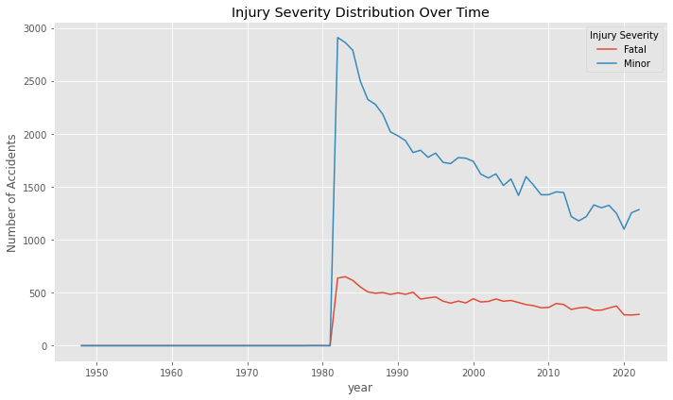
Data overview and main trends
Data source: National Transportation Safety Board (NTSB) aviation accident data (1962- 2023).
Total accident records: Over 50,000 aviation accident records, with the most prevalent accidents occurring in the 1980s.
Key trends
1980s peak: the number of total accidents per year was very high in the 1980s, exceeding 3,000 incidents annually. However, accidents have steadily declined since then, with accident frequency halving since that period.
Fatal and minor accidents: fatal accidents also peaked in the 1980s, with over 2,000 incidents, while minor accidents followed a similar decreasing trend over time.
Improved safety: over the decades, aviation has become progressively safer, even as global air traffic has increased significantly.

Slide 5
Data analysis

Slide 6

The power of communication

Slide 7

Overcoming nervousness
Confidence-building strategies

Slide 8
Engaging the audience
Make eye contact with your audience to create a sense of intimacy and involvement
Weave relatable stories into your presentation using narratives that make your message memorable and impactful
Encourage questions and provide thoughtful responses to enhance audience participation
Use live polls or surveys to gather audience opinions, promoting engagement and making sure the audience feel involved

Slide 9
Selecting visual aids
Enhancing your presentation

Slide 10
Effective delivery techniques
This is a powerful tool in public speaking. It involves varying pitch, tone, and volume to convey emotion, emphasize points, and maintain interest.
Pitch variation
Tone inflection
Volume control
Effective body language enhances your message, making it more impactful and memorable.
Meaningful eye contact
Purposeful gestures
Maintain good posture
Control your expressions

Slide 11
Navigating Q&A sessions
Know your material in advance
Anticipate common questions
Rehearse your responses
Maintaining composure during the Q&A session is essential for projecting confidence and authority. Consider the following tips for staying composed:
Stay calm
Actively listen
Pause and reflect
Maintain eye contact

Slide 12

Speaking impact
Your ability to communicate effectively will leave a lasting impact on your audience
Effectively communicating involves not only delivering a message but also resonating with the experiences, values, and emotions of those listening

Slide 13
Dynamic delivery
Learn to infuse energy into your delivery to leave a lasting impression
One of the goals of effective communication is to motivate your audience
Metric | Measurement | Target | Actual
Audience attendance | # of attendees | 150 | 120
Engagement duration | Minutes | 60 | 75
Q&A interaction | # of questions | 10 | 15
Positive feedback | Percentage (%) | 90 | 95
Rate of information retention | Percentage (%) | 80 | 85

Slide 14
Final tips & takeaways
Consistent rehearsal
Strengthen your familiarity
Refine delivery style
Pacing, tone, and emphasis
Timing and transitions
Aim for seamless, professional delivery
Practice audience
Enlist colleagues to listen & provide feedback
Seek feedback
Reflect on performance
Explore new techniques
Set personal goals
Iterate and adapt

Slide 15
Speaking engagement metrics
Impact factor | Measurement | Target | Achieved
Audience interaction | Percentage (%) | 85 | 88
Knowledge retention | Percentage (%) | 75 | 80
Post-presentation surveys | Average rating | 4.2 | 4.5
Referral rate | Percentage (%) | 10 | 12
Collaboration opportunities | # of opportunities | 8 | 10

Slide 16
Thank you
Brita Tamm
502-555-0152
brita@firstupconsultants.com
www.firstupconsultants.com

